Slide 1
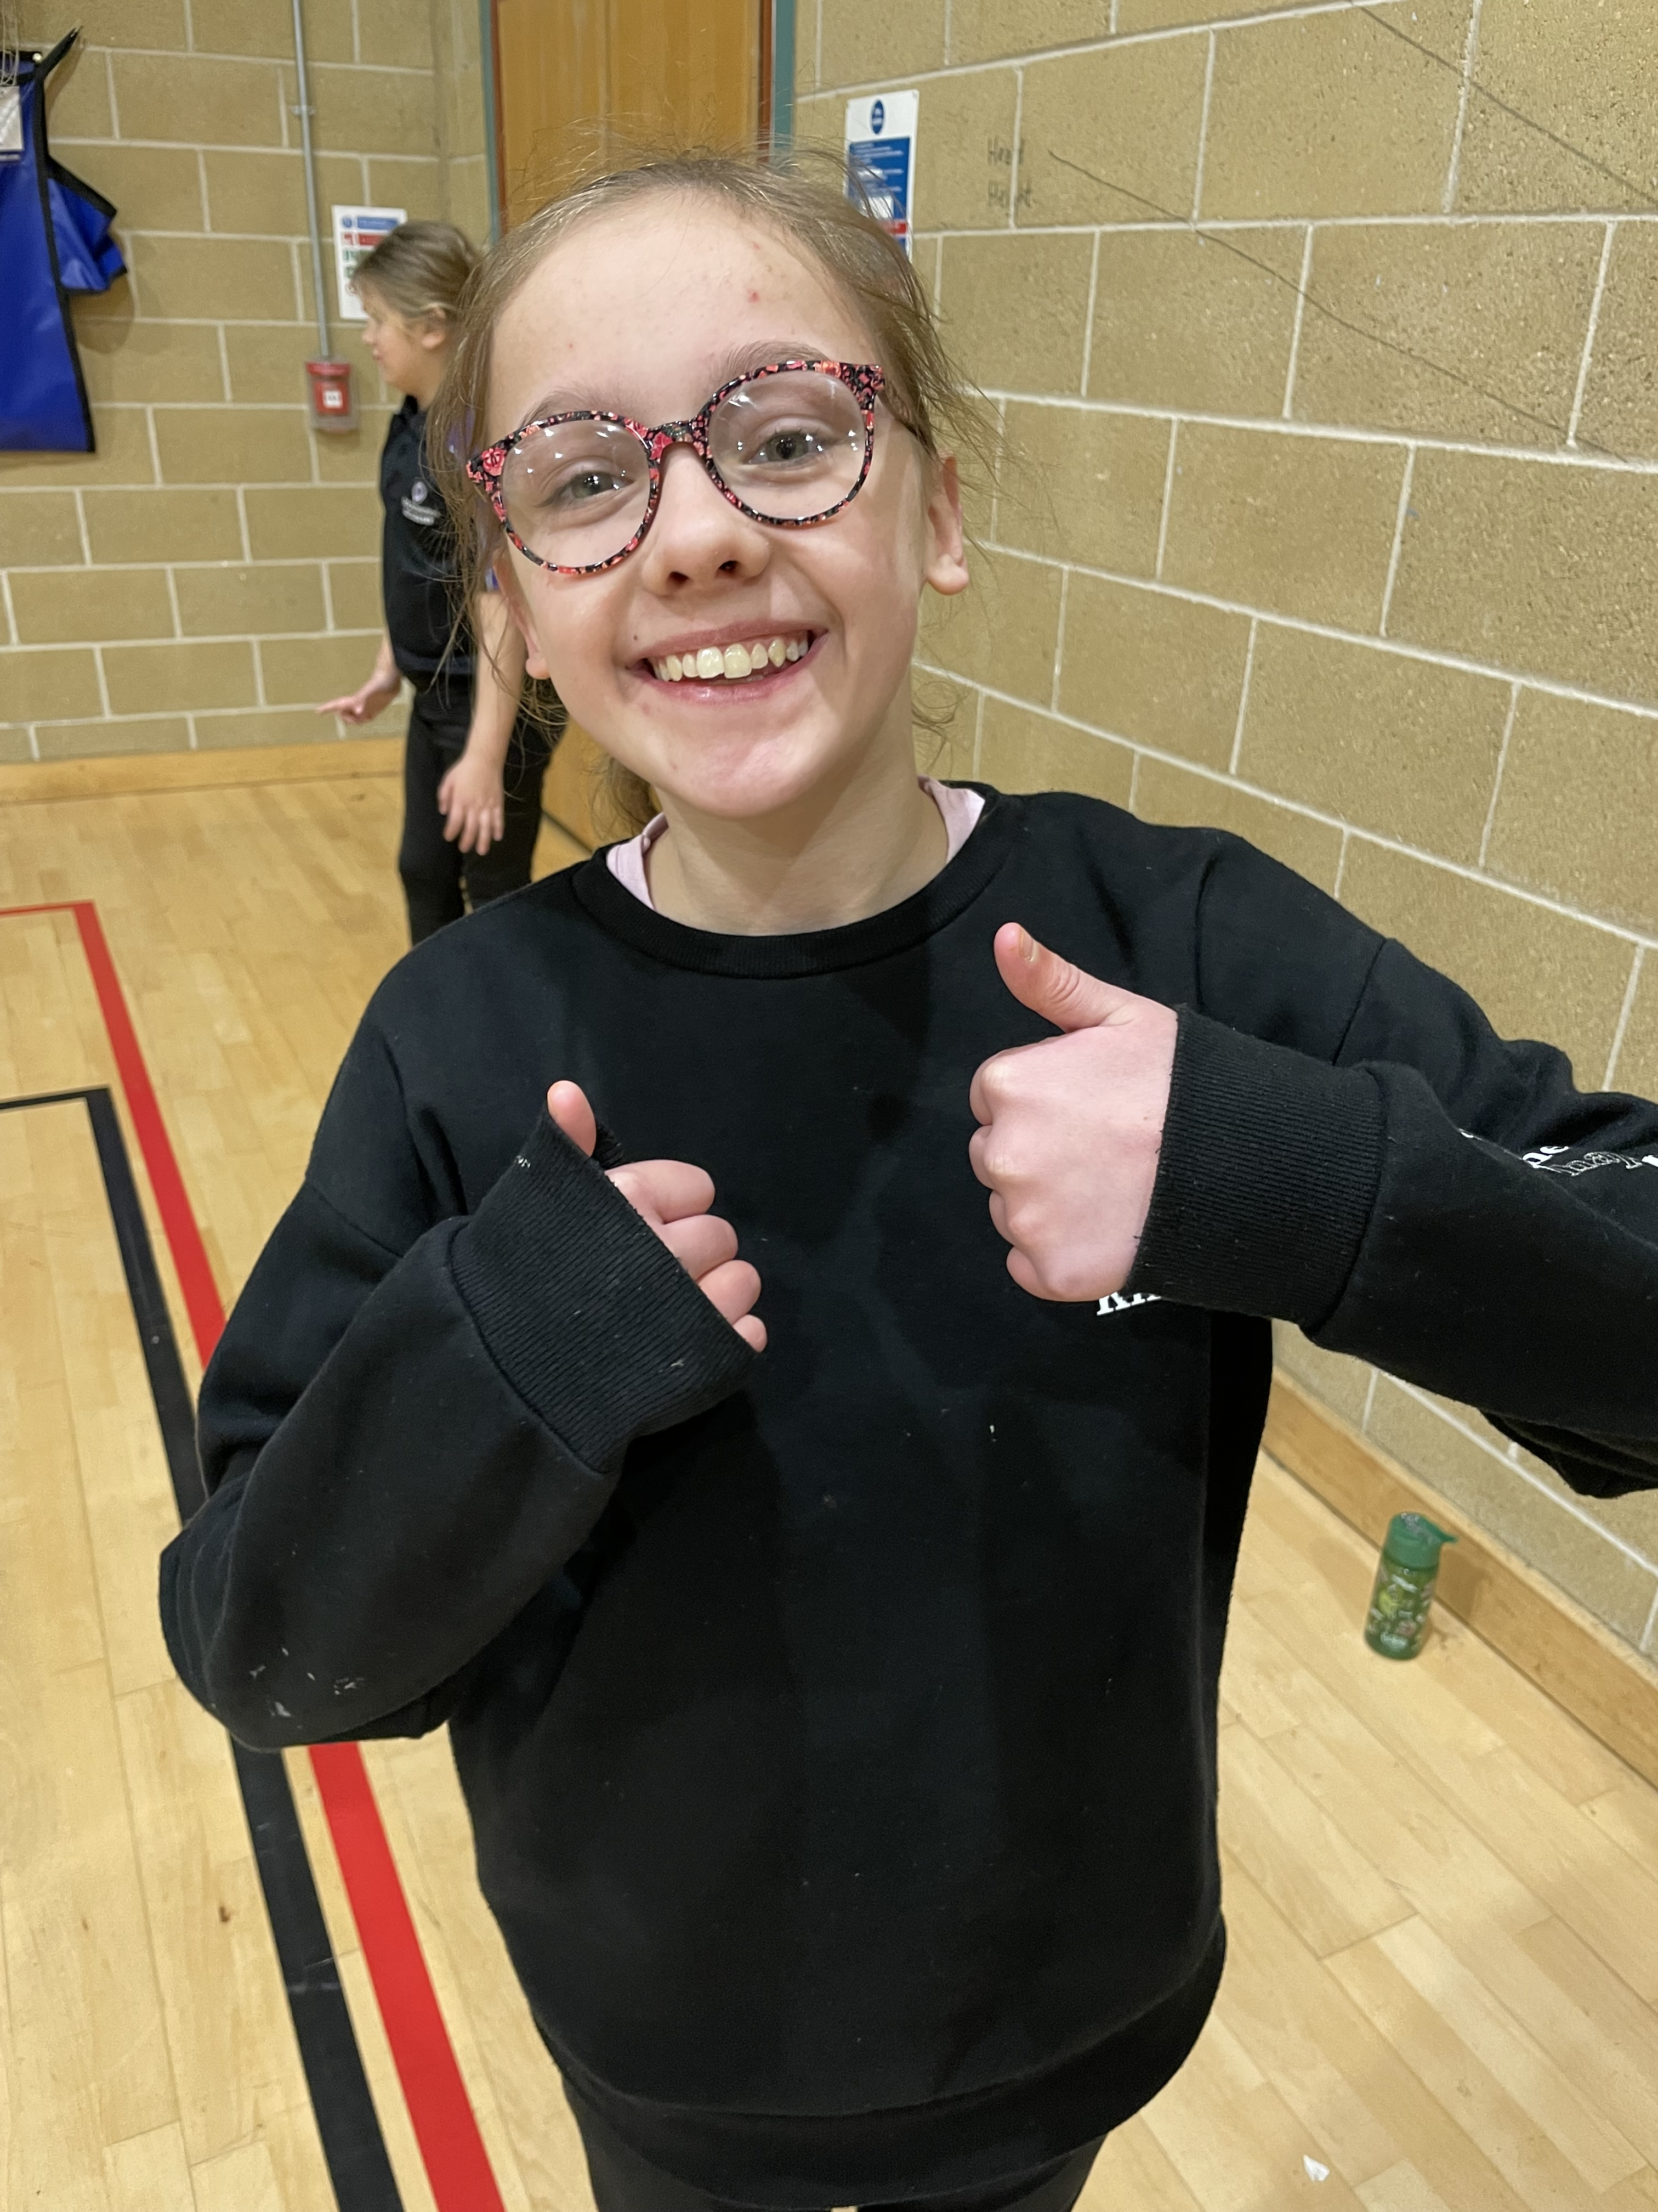
Our NeneGate Values
NeneGate School enshrines the five core values of the Meridian Trust:
We are committed to the pursuit of excellence: The School will reflect and encourage a commitment to continuous improvement that will create positive and optimistic ‘can do’ attitudes among students and staff, supporting pupils to reduce their dependence on others and self regulate. The School will systematically benchmark its practices against the very best in other schools to energise organisation, fuel ambition and stimulate improvement.
We value people: We will be uncompromising in our commitment to know and value every Pupil and support them to achieve academically and in the widest sense. This commitment underpins all aspects of all we will do.
We are committed to achievement for all: We are committed to the individual achievement of every student and recognise the flexibility and rigor – in terms of the curriculum, support, resources and monitoring – required to make this happen. Students’ transition and progression will be carefully planned and monitored to ensure that they achieve to their potential. All of this will be underpinned by a simple but highly effective ‘My Voyage’ approach that provides the focus of teachers, students and parents.

Slide 2
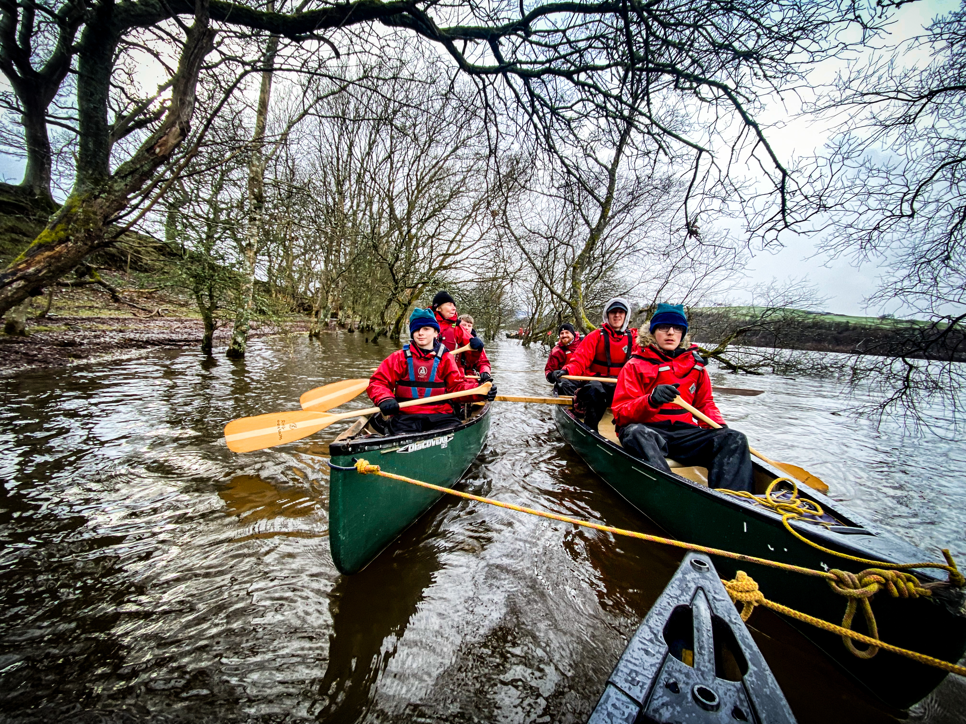
Our NeneGate Values
We will provide a high quality learning environment: We know how important it is to create the right environment for our pupils to learn. We are committed to maintaining and developing our built environment. The classroom environment will provide students with stimulating and varied learning opportunities that engage and motivate them. Outside the classroom, students will feel safe, happy and secure, and will be inspired and supported to learn in all environments. We value learning which happens outside of the Classroom
We will extend the boundaries of learning: We will explore the role of the school as a source of pride and a centre of expertise. This outward focus will provide new and exciting opportunities to extend experience, skills and confidence, reflected in unique local and national partnerships as well as our ‘Pledges’. For staff and the School as a whole, we will explore ways to share our knowledge, expertise and facilities with other academies, schools and groups within our community.
PLEDGES: Participation, Leadership, Excellence, Diversity, Giving, Environmental & Service.

